Slide 1

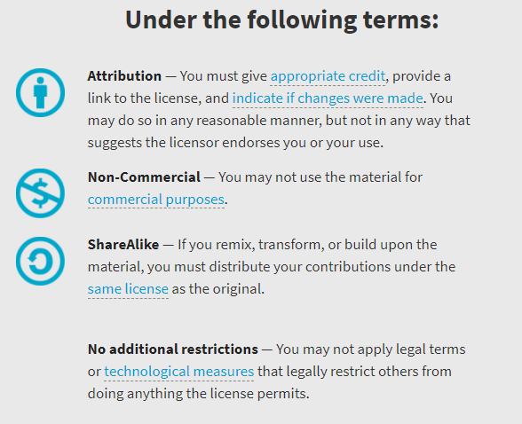
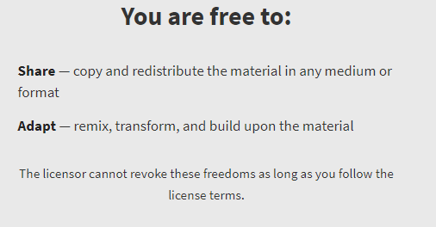
AQA GCSE Chemistry Required Practicals – Integrated Instructions – v0.1 – 09/07/18
© David Paterson, 2018
Shared under a Creative Commons “Attribution-NonCommercial-ShareAlike” license. https://creativecommons.org/licenses/by-nc-sa/2.0/uk/
Minor changes of layout along with changes in curricular references made by Chris Lloyd at SSERC.

Slide 2

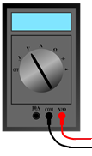


Electrode potentials
Mg
◆ Cut 2 strips of filter paper 
❖ Place in a cross inside a petri dish
⬥ Place one of your pieces of metal on each ‘arm’ of the cross. 
Fe
Zn
Cu
 Moisten all of the paper with drops of potassium nitrate 
 Use a multimeter (set to 20V) to measure the voltage of each pair of metals 
Fe
Fe
Zn
Mg
National 4 – Properties of metals & alloys
Zn
Mg
Cu
Cu

