Slide 1

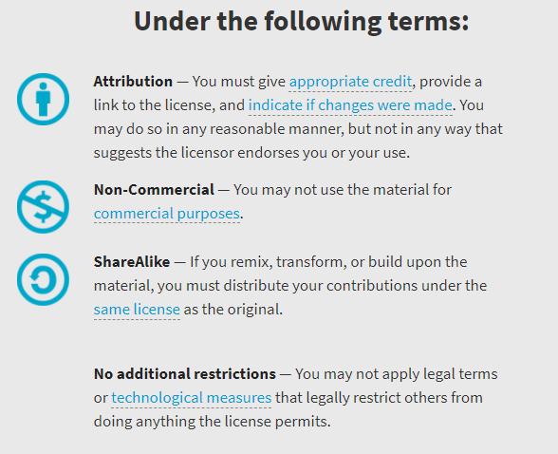
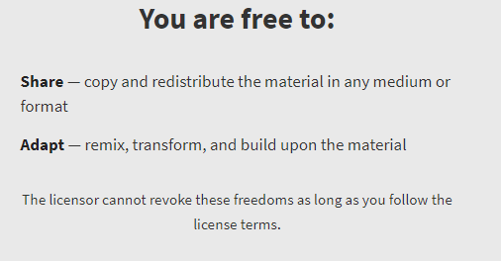
AQA GCSE Chemistry Required Practicals – Integrated Instructions – v0.1 – 09/07/18 © David Paterson, 2018 Shared under a Creative Commons “Attribution-NonCommercial-ShareAlike” license. https://creativecommons.org/licenses/by-nc-sa/2.0/uk/ Minor changes of layout along with changes in curricular references made by Chris Lloyd at SSERC.

Slide 2



Making a salt by neutralisation
⬥ 1.8-2.0g copper oxide. Add half and swirl, wait 1 minute, add the other half. 
 Filter copper sulphate solution (max 3 min) 
❖ 15cm³ 1 mol l⁻¹ sulphuric acid in TT – wait 2 minutes 
◆ Half fill beaker with just boiled water 
xxxxxxxxxxxxxxxxxxxxx
 Pour filtered heated copper sulphate into the evaporating dish; observe for 5 minutes 
National 5 Chemistry: Acids & Bases – Neutralisation
Wear goggles (BS EN166 3).
Do not pour your solution down the sink.
 Remove funnel, then gently heat solution (half-blue) for 3 minutes – DO NOT BOIL DRY 

