Slide 1

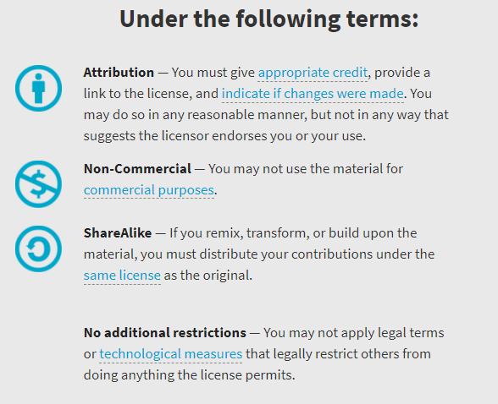
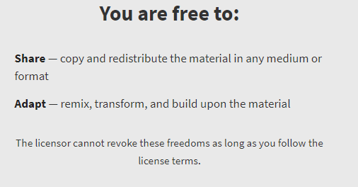
AQA GCSE Chemistry Required Practicals – Integrated Instructions – v0.1 – 09/07/18 © David Paterson, 2018 Shared under a Creative Commons “Attribution-NonCommercial-ShareAlike” license. https://creativecommons.org/licenses/by-nc-sa/2.0/uk/ Minor changes of layout along with changes in curricular references made by Chris Lloyd at SSERC.

Slide 2


Enthalpy of Neutralisation
❖ Stir until temperature stops changing – record temperature
⬥ 5cm³ alkali
 Repeat until a total of 40cm³ alkali is added
 Repeat Step 
◆ 30 cm³ acid (measuring cylinder)
National 5 – acids & bases: neutralisation
Higher – Chemical energy
2 mol l⁻¹ Hydrochloric acid & 2mol l⁻¹ sodium hydroxide
Wear goggles (BS EN166 3).

