Slide 1

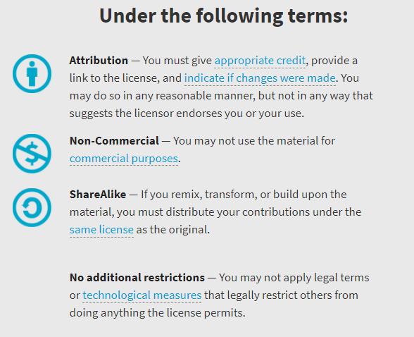
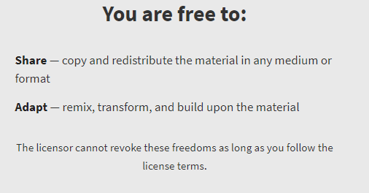
AQA GCSE Chemistry Required Practicals – Integrated Instructions – v0.1 – 09/07/18
© David Paterson, 2018
Shared under a Creative Commons “Attribution-NonCommercial-ShareAlike” license. https://creativecommons.org/licenses/by-nc-sa/2.0/uk/
Minor changes of layout along with changes in curricular references made by Chris Lloyd at SSERC.

Slide 2


Neutralisation by titration
◆ 25.0 cm³ NaOH (pipette)
❑  
 Fill to 0.0 cm³ with H₂SO₄
❑  
 Measure and record volume
❑  
❖ 5-10 drops of indicator
❑  
 Add H₂SO₄ and …. 😐
❑  
⬥ Tap is closed
❑  
 ☺… swirl until colour change
❑  
National 5 Chemistry: Acids & Bases – Neutralisation
Wear safety spectacles/goggles as instructed (depending on the concentration)

