Slide 1

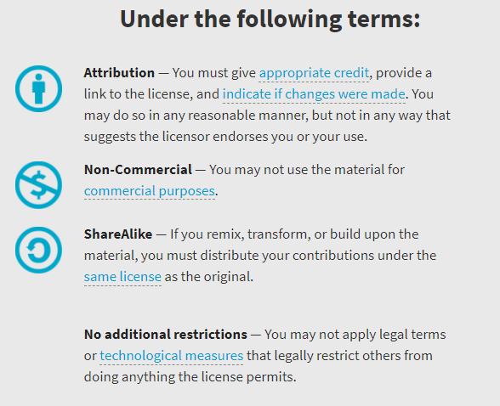
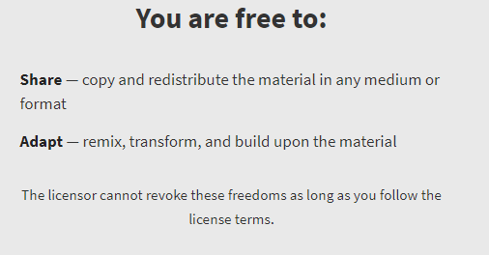
AQA GCSE Chemistry Required Practicals – Integrated Instructions – v0.1 – 09/07/18 © David Paterson, 2018 Shared under a Creative Commons “Attribution-NonCommercial-ShareAlike” license. https://creativecommons.org/licenses/by-nc-sa/2.0/uk/ Minor changes of layout along with changes in curricular references made by Chris Lloyd at SSERC.

Slide 2
Chromatography of food dyes
 Remove chromatogram and draw the solvent front in pencil 
⬥ Label the spots 
 Place chromatogram in beaker 
A B C D U
❖ Spot each food colouring in turn:
A  B  C 
D  U 
 Roll paper round glass rod and tape 
◆ Draw base line in pencil 
 Add water into beaker 
National 4 – chemical analysis

