Slide 1

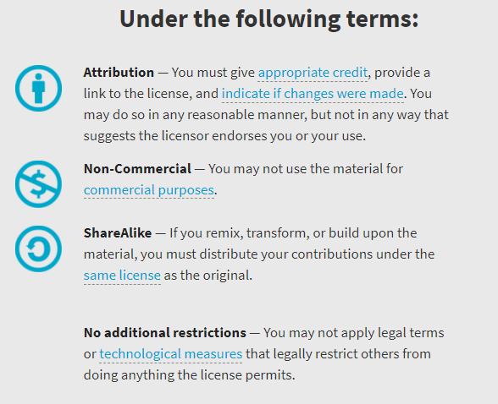
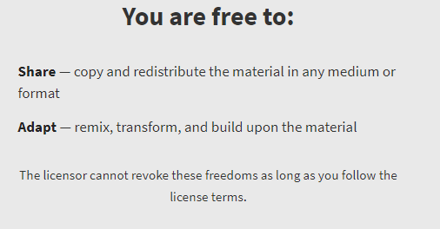
AQA GCSE Chemistry Required Practicals – Integrated Instructions – v0.1 – 09/07/18
© David Paterson, 2018
Shared under a Creative Commons “Attribution-NonCommercial-ShareAlike” license. https://creativecommons.org/licenses/by-nc-sa/2.0/uk/
Minor changes of layout along with changes in curricular references made by Chris Lloyd at SSERC.

Slide 2



Electrolysis of solutions
 Power pack 4V 5 minutes
❑   
◆ 50.0 cm³ electrolyte solution
❑   
⬥ Electrodes
❑   
00.00
 Damp blue litmus paper gas test
❑   
❖ Petri dish lid
❑   
 Observe positive electrode and record
❑   
 Observe negative electrode and record
❑   
National 4 – Properties of metals & alloys
National 5 – metals
1 – copper chloride
2 – copper sulphate
3 – sodium chloride
4 – sodium sulphate
Wear goggles (BS EN166 3).
Do not pour your solution down the sink.

