Slide 1

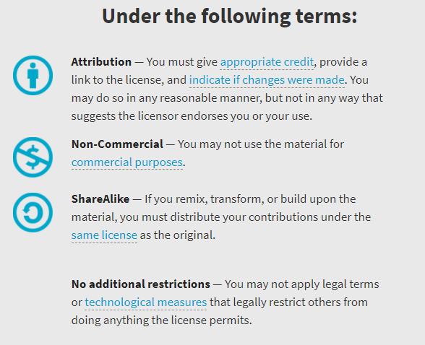
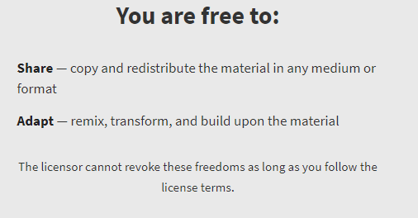
AQA GCSE Chemistry Required Practicals – Integrated Instructions – v0.1 – 09/07/18
© David Paterson, 2018
Shared under a Creative Commons “Attribution-NonCommercial-ShareAlike” license. https://creativecommons.org/licenses/by-nc-sa/2.0/uk/
Minor changes of layout along with changes in curricular references made by Chris Lloyd at SSERC.

Slide 2

Identifying anions
❖ CARBONATE TEST: Add 1cm³ HCl

⬥ CARBONATE TEST: If bubbles, limewater test 
◆ Separately 1cm³ each sodium salt solution   
 HALIDE TEST:
3 drops nitric acid
1 cm³ silver nitrate

 SULFATE TEST:
3 drops nitric acid
1 cm³ barium chloride

National 4 – chemical analysis
National 5 – chemical analysis
Wear eye protection

