Slide 1

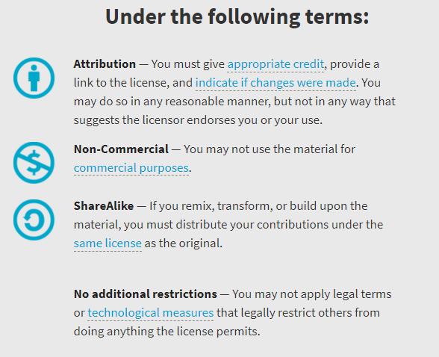
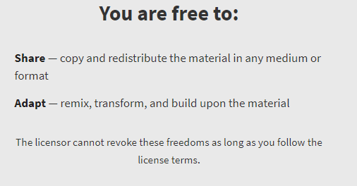
AQA GCSE Chemistry Required Practicals – Integrated Instructions – v0.1 – 09/07/18
© David Paterson, 2018
Shared under a Creative Commons “Attribution-NonCommercial-ShareAlike” license. https://creativecommons.org/licenses/by-nc-sa/2.0/uk/
Minor changes of layout along with changes in curricular references made by Chris Lloyd at SSERC.

Slide 2


Rate of reaction – thiosulphate/acid reaction
❖ Add 40cm³   
30cm³   
20cm³   
10cm³   
no cm³   
water (measuring cylinder)
⬥ Add 10cm³   
10cm³   
10cm³   
10cm³   
10cm³   
acid (measuring cylinder)
◆ Add 10cm³   
20cm³   
30cm³   
40cm³   
50cm³   
sodium thiosulphate (measuring cylinder)
 Swirl flask
Place on cross
Start timer
00.00
 Stop timer when cross has disappeared – record time
National 4 – rates of reaction
National 5 – rates of reaction
2 mol l⁻¹ Hydrochloric acid
Wear eye protection

