Slide 1

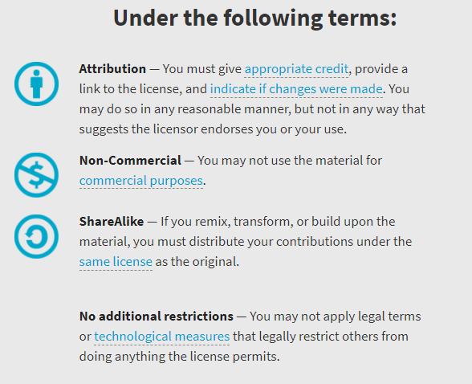
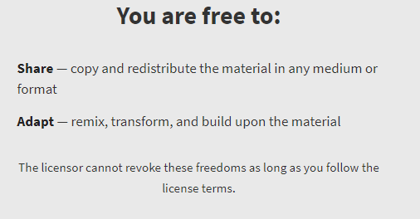
AQA GCSE Chemistry Required Practicals – Integrated Instructions – v0.1 – 09/07/18 © David Paterson, 2018 Shared under a Creative Commons “Attribution-NonCommercial-ShareAlike” license. https://creativecommons.org/licenses/by-nc-sa/2.0/uk/ Minor changes of layout along with changes in curricular references made by Chris Lloyd at SSERC.

Slide 2

Simple Distillation
 Attach delivery tube 
⬥ Clamp flask 
 Ice water 
❖ Anti-bumping granules 
xxxxxxxxxxxxxxxxxxxxx
◆ 40cm³ ‘sea water’ 
 Heat until 5 cm³ distilled water collected 
CfE Level 3 16a
I can differentiate between pure substances and mixtures in common use and can select appropriate physical methods for separating mixtures into their components.

