Slide 1

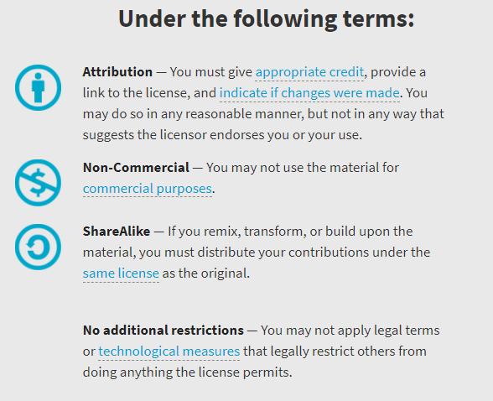
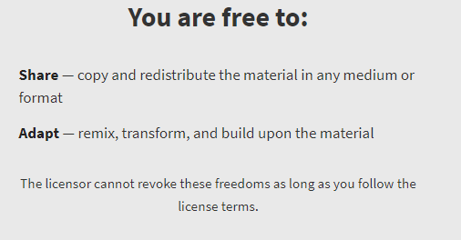
AQA GCSE Chemistry Required Practicals – Integrated Instructions – v0.1 – 09/07/18 © David Paterson, 2018 Shared under a Creative Commons “Attribution-NonCommercial-ShareAlike” license. https://creativecommons.org/licenses/by-nc-sa/2.0/uk/ Minor changes of layout along with changes in curricular references made by Chris Lloyd at SSERC.

Slide 2

Dissolved solids in water
◆ 1 cm³ water sample    
 Weigh empty evaporating dish and record 
3.45 g
❖ 3-4 drops universal indicator
❑   
 4 cm³ water sample    
 Repeat for each water sample
⬥ Observe and record colour
❑   
 Use water bath to evaporate water sample    
xxxxxxxxxxxxxxxxxxxxx
 Remove evaporating dish (TONGS), dry base and weigh and record
❑   
CfE Level 3 16a
I can differentiate between pure substances and mixtures in common use and can select appropriate physical methods for separating mixtures into their components.
3.78 g

