Slide 1
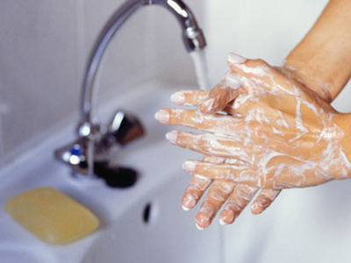
Beat
those
bugs!
Kate Andrews
Lorraine Bruce

Slide 2
Beat those bugs
Aims of this session
Practical activities for CfE
Hands-on opportunities
Strategies to support CfE
Build confidence

Slide 3
Beat those bugs
Practical activities - Where are those microorganisms?
- How do you control microorganisms? (1)
- How do you control microorganisms? (2)
- Toilet tissue challenge
Discussion - Germs
- When should you wash your hands?
- Topical science

Slide 4
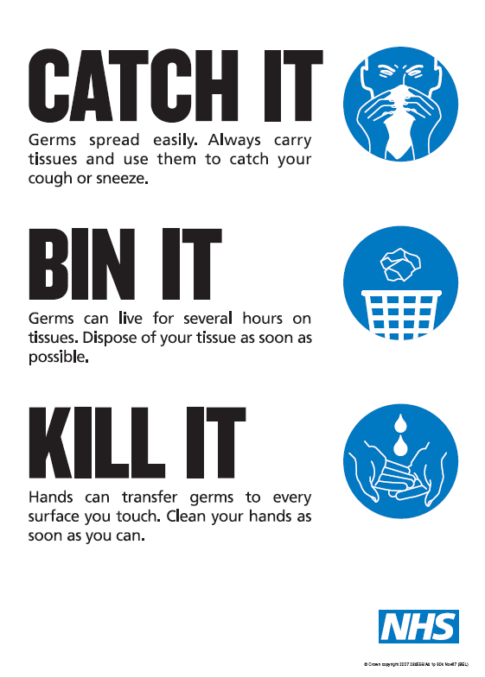

Slide 5
Beat those bugs
What message(s) might your pupils take from the poster? How might they respond to :
What are ‘germs’?
Where do you find ‘germs’?
How do you know that ‘germs’ are there?

Slide 6
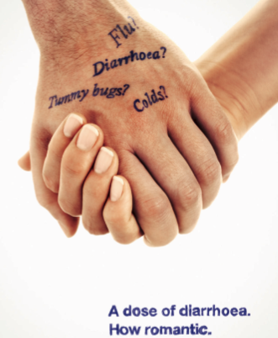

Slide 9
Beat those bugs
Purpose of discussion activity:
Identify misconceptions
Scientific language
Formative assessment (prior learning)

Slide 10
Beat those bugs
Why practical microbiology?
Curriculum... ?
Engaging... ?
Life... ?

Slide 11
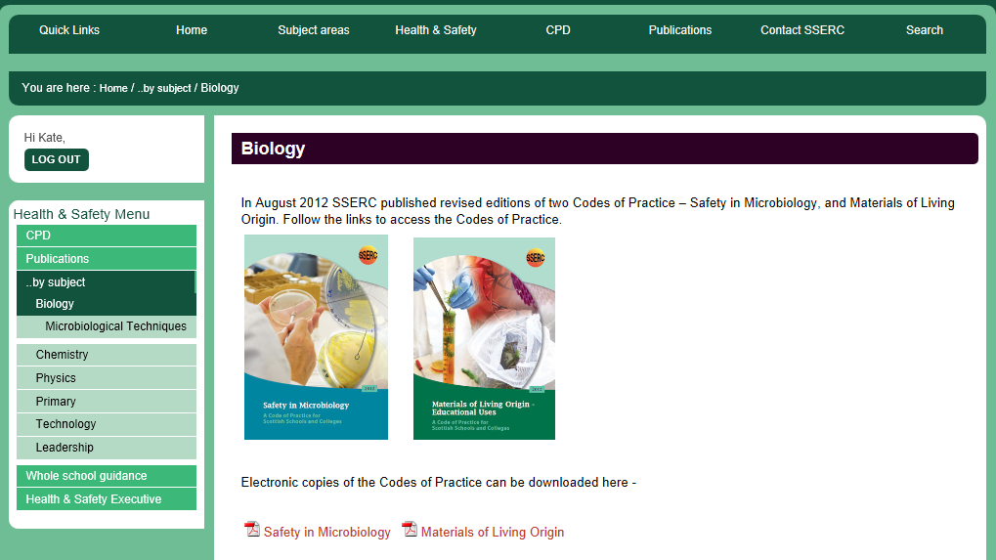
Microbiology Safety - Level 3
www.sserc.org.uk

Slide 12
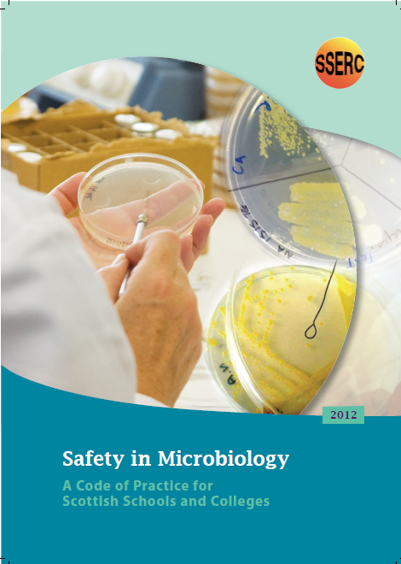

Slide 13
Beat those bugs
Growing microorganisms
(S1, S2 pupils)
Nutrient medium
- Liquid
- Solid
X
✔

Slide 14
Where are those microorganisms?
Where do you find ‘germs’?
How do you know that ‘germs’ are there?

Slide 15
Label on underside:
initials
date
sample

Slide 16
Beat those bugs
Where are those microorganisms?
Dip cotton bud in tap water
Rub on side one of plate
inoculate
control
test
Wipe test area with same bud
Rub on side 2 of plate
water
test area

Slide 17
Beat those bugs
Choose area carefully:
- desk top
- mobile phones?
- bag handles?
- outer window sill?
- computer keyboard?
- sink?

Slide 18
Where are those microorganisms?
Teaching points:
Labelling carefully...
What is the purpose of the ‘control’ ?

Slide 19
Beat those bugs
Where are those microorganisms?
Dip cotton bud in tap water
Rub on side one of plate
inoculate
control
test
Wipe test area with same bud
Rub on side 2 of plate
water
test area

Slide 20
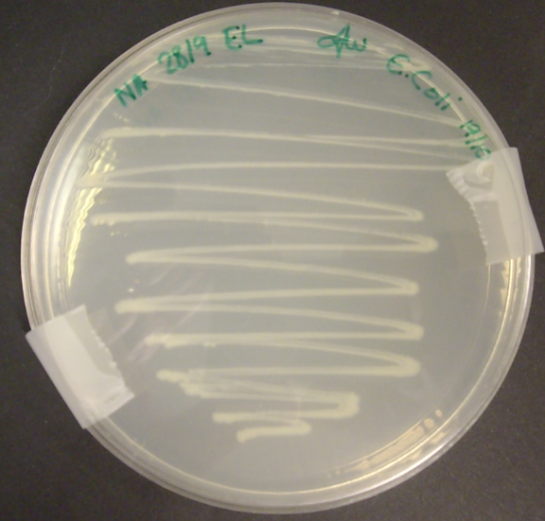
Safety
Seal plates diametrically, small pieces!
Incubate at room temperature
- small scale
- containment
- temperature

Slide 21
Where are those microorganisms?
How do we know they are there?
Are there microorganisms on:
your skin?
the workbench?
Microorganisms are found almost everywhere!

Slide 22
Safety
Do not open plates
Sterilise by autoclaving (technician)
Dispose of with normal rubbish
- no exposure of ‘unknowns’

Slide 23
How do you control microorganisms? (1)
Keep it hot, keep it cold

Slide 24
Beat those bugs
Making the yeast suspension:
Add ~ 3 cm³ fresh tap water to ~ 0.1 g dried yeast
Shake well (about 1¹/2 min) until yeast is fully suspended

Slide 25
Keep it hot, keep it cold
Inoculate plates with yeast
refrigerator
room
room
room
oven
room

Slide 26
Teaching points.......
Explanation of purpose
Explanation of procedure
Predictions
Interpreting results
Conclusions

Slide 27
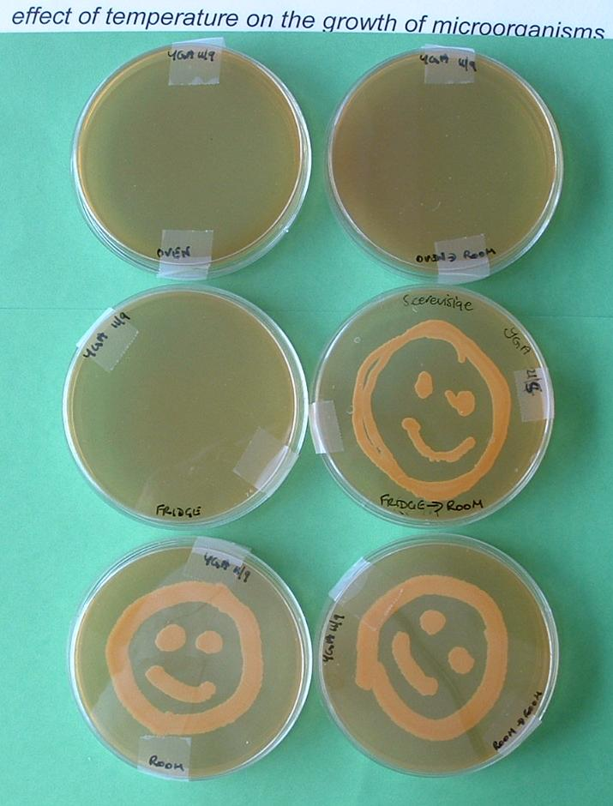
Beat those bugs
keep it hot,
keep it cold

Slide 28
How do you control microorganisms (2)
Can you remove microorganisms?

Slide 29
Can you remove microorganisms?
Dampen swab
Sample test area
Streak on agar
Discard swab
AB 28.10.02
1
Label plate
2
3
Clean test area with water
Sample test area
Streak on agar
Discard swab
Clean test area with cleanser
Sample test area
Streak on agar
Discard swab

Slide 30
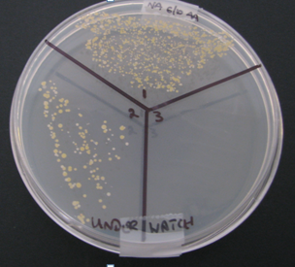
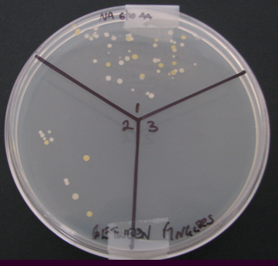
Beat those bugs
Results

Slide 31
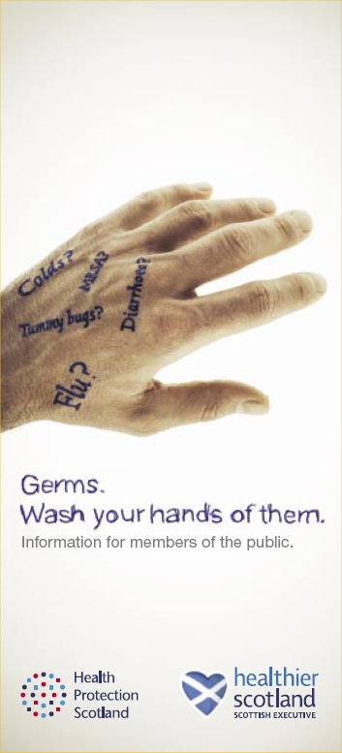
Beat those bugs
http://www.washyourhandsofthem.com

Slide 33
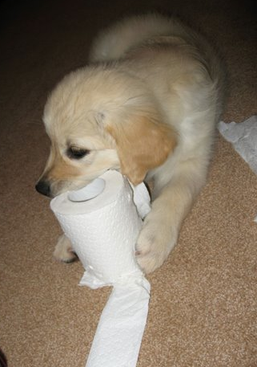
Beat those bugs
Toilet tissue challenge……
2 YGA plates
Yeast culture / suspension
Small bottle
Water
Toilet tissue
Cleansing solutions

Slide 34
Beat those bugs
Plate 1
Plate 2 (bottom)
Label plate with:
your initials
date
tissue brand or number of layers
Flood plate with 2-3 cm³ yeast suspension, discard excess
20.08
Andrex (2)
kc
2
1
4
3

Slide 35
Simulating the ‘test’
Beat those bugs
Wash and dry hands
Cover forefinger with 1 layer of toilet tissue
Draw across Plate 2
Discard tissue
Roll fingertip on area1 of Plate 1
Wash and dry finger
Roll same fingertip on area 2
1
2
3
4
Plate 2
Repeat process with 2 layers

Slide 36
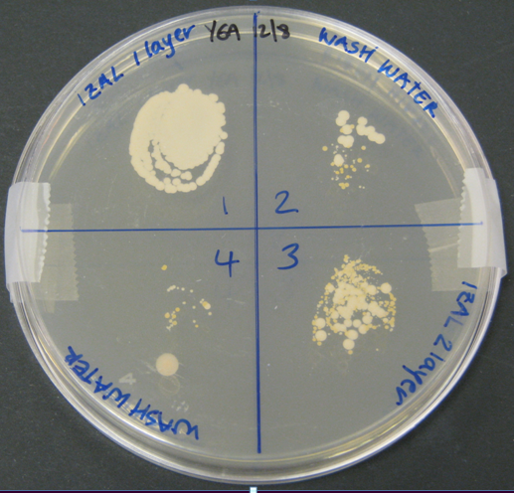
Beat those bugs

Slide 37
Safety
Seal plates
Incubate at room temperature
- small scale
- containment
- temperature

Slide 38
Context, discussion......
topical science
Beat those bugs

Slide 39
Beat those bugs
Curriculum for Excellence
I have contributed to investigations into the different types of micro-organisms and can explain how their growth can be controlled SCN 3-13b
Through research and discussion, I have contributed to evaluations of media items with regard to scientific content and ethical implications SCN 3-20b

Slide 40
Beat those bugs
Curriculum for Excellence
I am learning to assess and manage risk, to protect myself and others, and to reduce the potential for harm when possible HWB 3-16a
I can apply food safety principles when buying, storing, preparing, cooking and consuming food
HWB 3-33a

Slide 41
Beat those bugs
Curriculum for Excellence
Learning in the sciences will enable me to:
Develop the skills of scientific enquiry and investigation using practical techniques
Apply safety measures and take necessary actions to control risk and hazards

