Slide 1

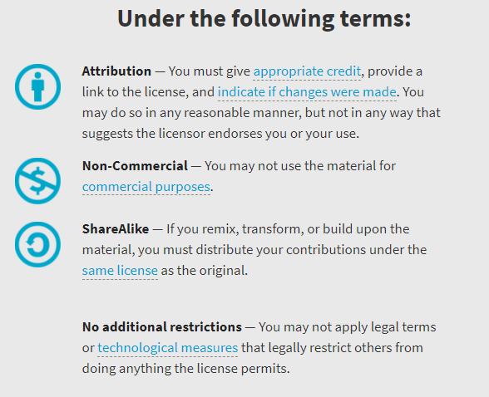
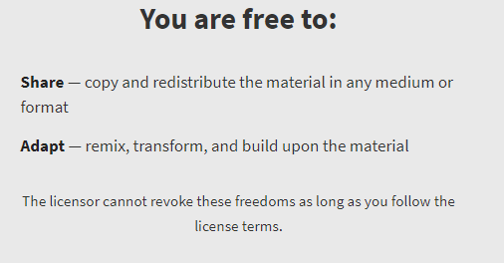
AQA GCSE Chemistry Required Practicals – Integrated Instructions – v0.1 – 09/07/18 © David Paterson, 2018 Shared under a Creative Commons “Attribution-NonCommercial-ShareAlike” license. https://creativecommons.org/licenses/by-nc-sa/2.0/uk/ Minor changes of layout along with changes in curricular references made by Chris Lloyd at SSERC.

Slide 2

Rate of reaction – magnesium/acid reaction
◆ Set up gas collection apparatus 
 QUICKLY place bung into conical flask AND start the timer 
 Measure and record volume every 10 s, for 100 s.
00.00
❖ 50cm³ 2.0M acid 
00.00
⬥ 3cm magnesium ribbon 
National 4 – rates of reaction
National 5 – rates of reaction
2 mol l⁻¹ Hydrochloric acid
Wear eye protection

